Slide 1
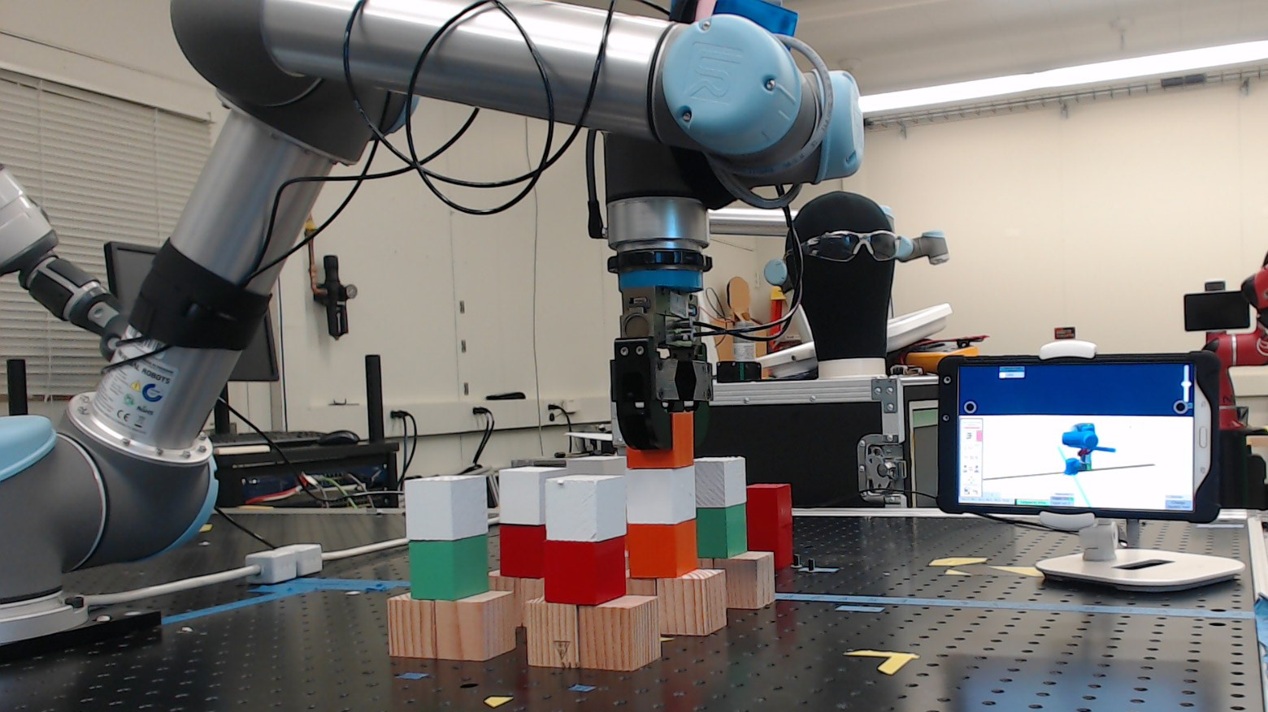
Adaptive Metrics and Performance Analysis Tool for Human-Robot Interaction
Author: Esteban Segarra Martinez Mentor: Dr. Jeremy Marvel

Slide 2
Introduction
Collaborative Robotics is an emerging field of robotics where the core concept is improving the social interaction between human and robot.
This is usually known as human-robot interaction (HRI); the interaction between robot and human and the feedback between each other
NIST is creating standards that can quantify the user experience between human and robot.
NIST Engineering Laboratory

Slide 3
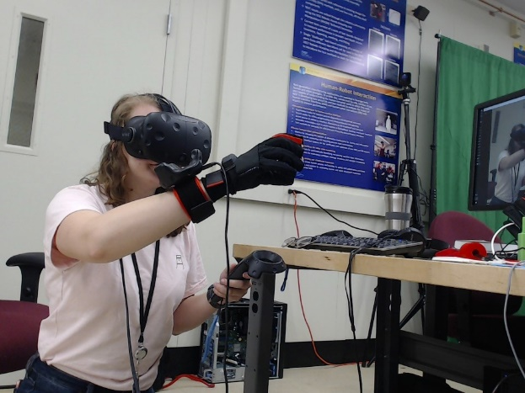
Background
The quality of HRI depends on the effectivity of human-machine interfaces (HMI) to provide reliable information to the operator
HRI is important to cut down on training costs, improve factory floor remodeling times, and reduce the amount of practice time while utilizing a robot’s HMI
HMI is used by an operator for control and feedback on a robot system and varies widely in operation and appearance
Figure 1 – Example of a state-of-the-art HMI
NIST Engineering Laboratory

Slide 4
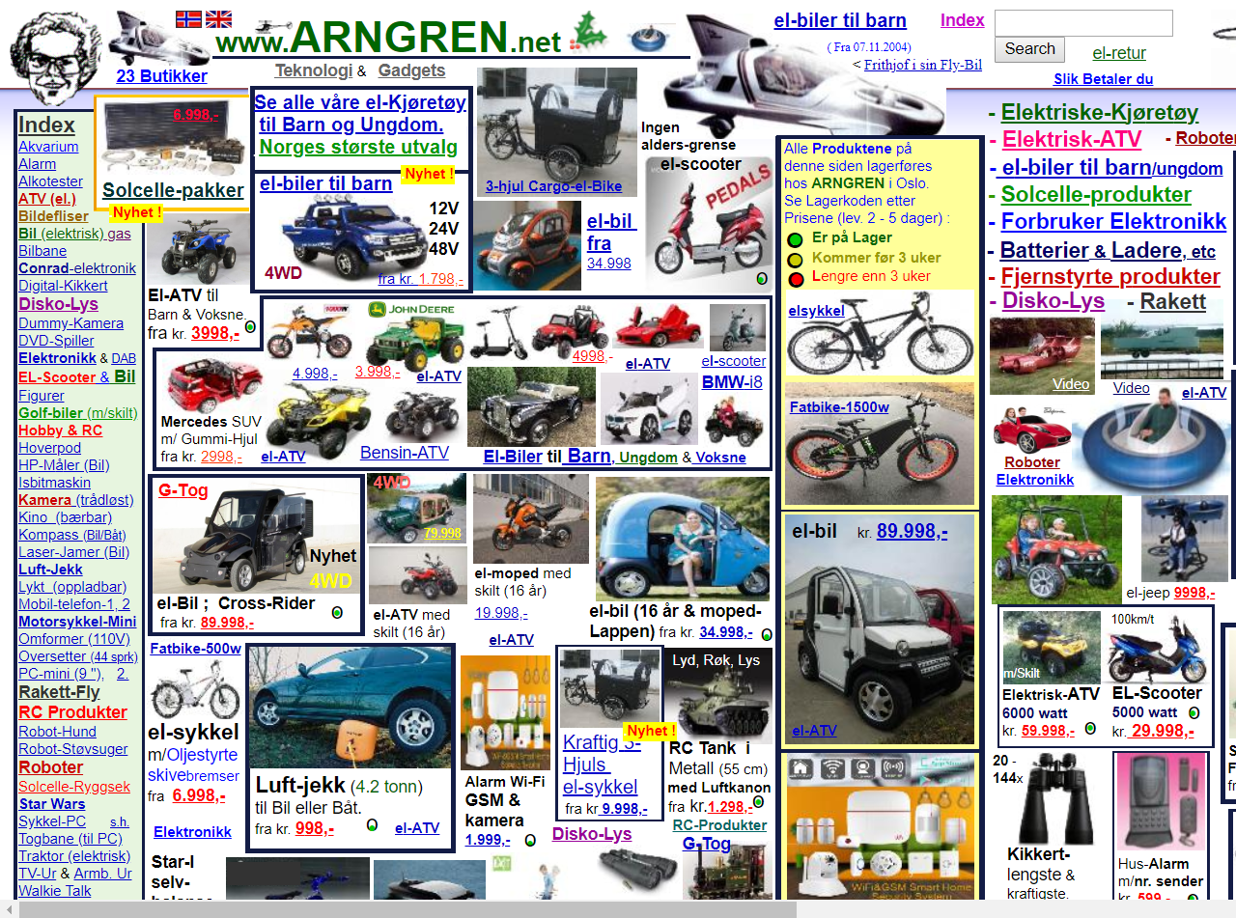
Objective
A tool capable of quantifying the effectivity and performance of a HRI UI system as used by an operator with an industrial robot
Demonstrate the differences between a good UI and a poorly designed one and determining best practices
Through application of a real industrial setting, showcase the difference in performance from using a good UI in contrast to current industry standards
Figure 2 – Convoluted UI design
NIST Engineering Laboratory

Slide 5
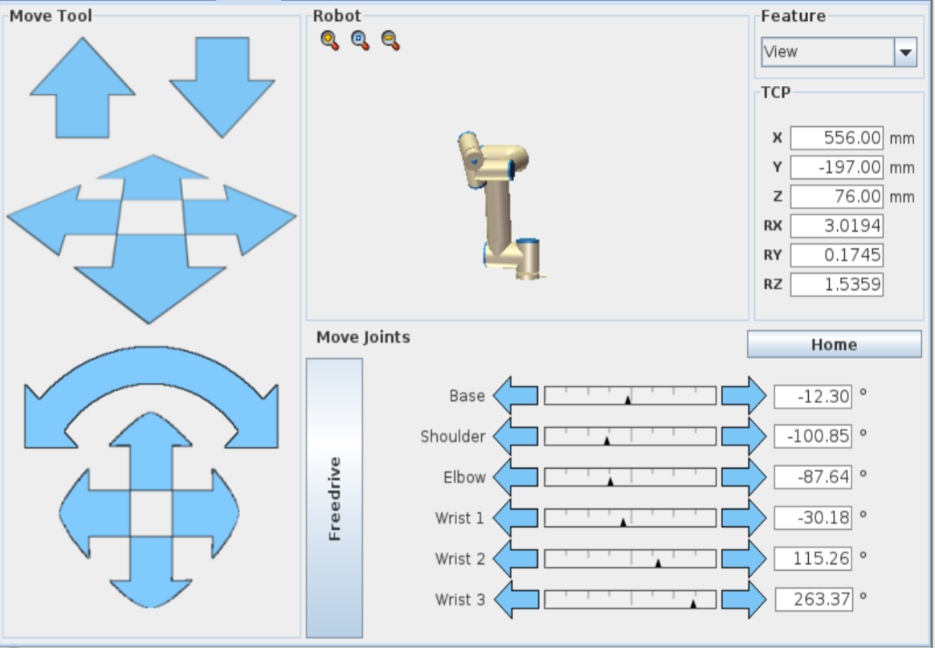
Figure 2 – UI design choice for an industrial robot
NIST Engineering Laboratory

Slide 6
Methodology
To determine good quantification metrics for HMI, different types of interfaces should be designed. These interfaces should allow the user to experience different features of the interface
Researchers can determine what features of control, feedback, and the general layout would work most effectively for users using the interface.
Some metrics used to quantify the experience include:
Effectiveness
Efficiency
Reaction time
Precision
NIST Engineering Laboratory

Slide 7
Setup
To test scenarios for UI experience the system should allow researchers to tweak and change the interface to observe for changes
The setup consists of a tablet with a modifiable interface and the inclusion of a motion capture system to track user position
With this relatively simple system, researchers will be able to determine metrics for the system based on feedback from different interfaces and polling different humans testing the system
NIST Engineering Laboratory

Slide 8
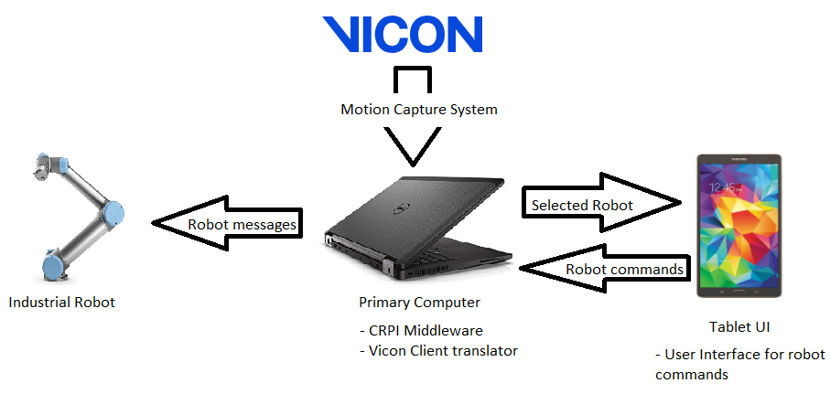
Setup – Hardware
Figure 3 – System Overview breakdown
NIST Engineering Laboratory

Slide 9
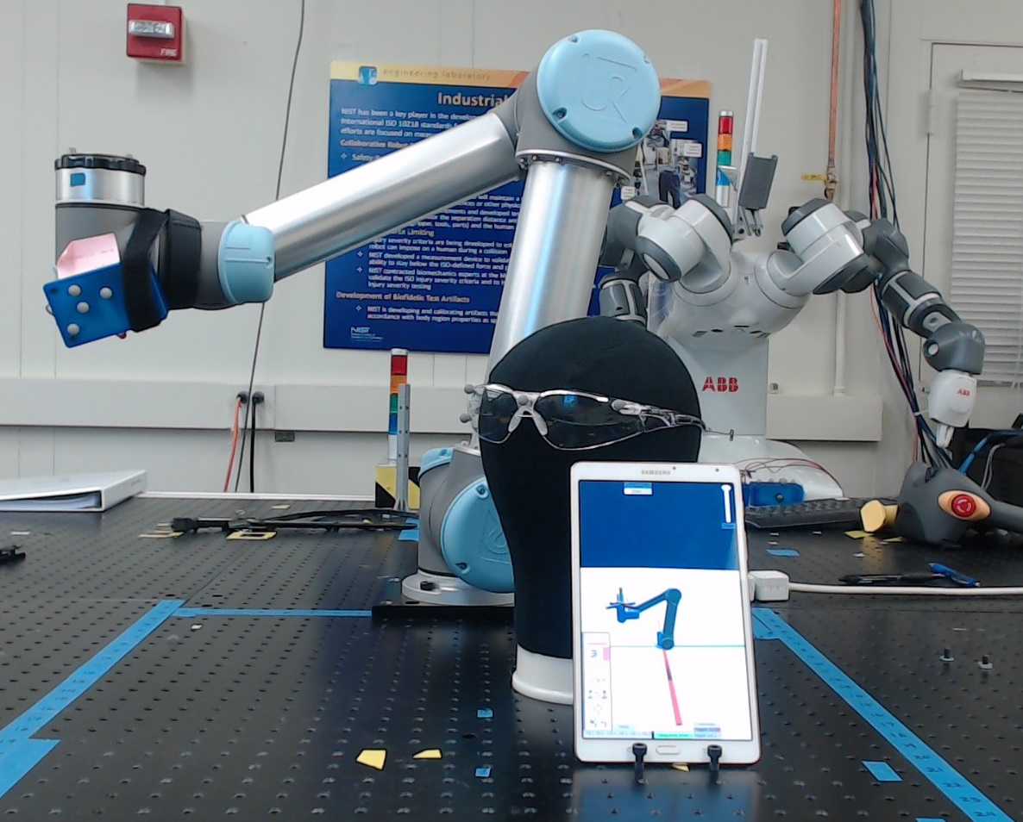
Setup – Hardware Setup
Motion Capture system
Main User Interface
NIST Engineering Laboratory

Slide 10
Setup – Software Components
The system is divided into several sub-components that allow the design to be portable and flexible for metric studies
Collaborative Robotics Programming Interface (CRPI) allows the program to send commands to the robot from the tablet to the robot
The motion capture system relays data from a separate server whereupon a separate Unity instance calculates the position of items and determines what robot is the user looking at
NIST Engineering Laboratory

Slide 11
Video Demonstration
NIST Engineering Laboratory

Slide 12
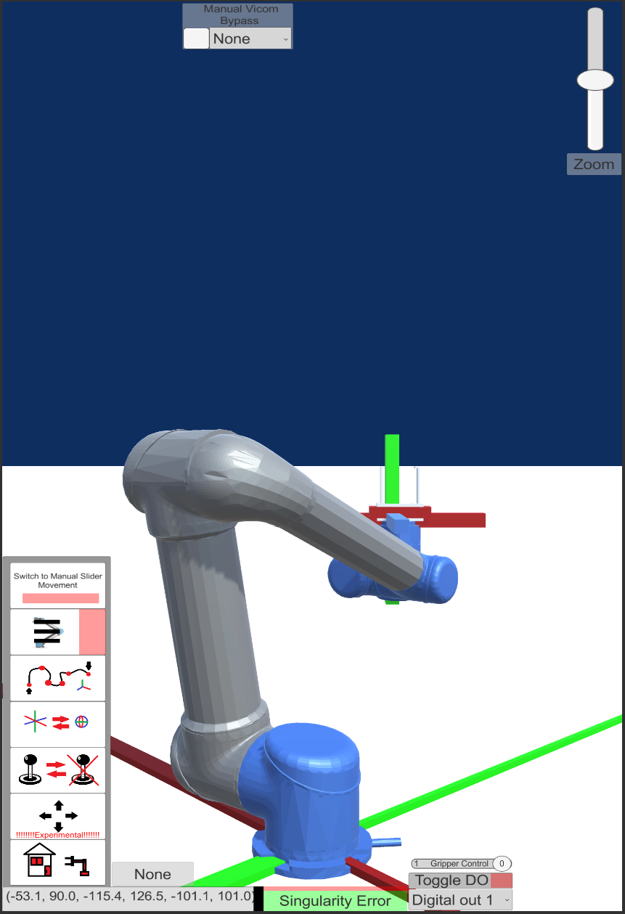
Result
From the preliminary results from the designed user interfaces, we able to setup the system for controlling the robot
Metrics from the user such as the amount of points/effort taken to complete a task were noted and can be taken from the data
Task completion performance is taken into account such as the amount of time that was taken to complete it as well as comparing it against a control task
NIST Engineering Laboratory

Slide 13
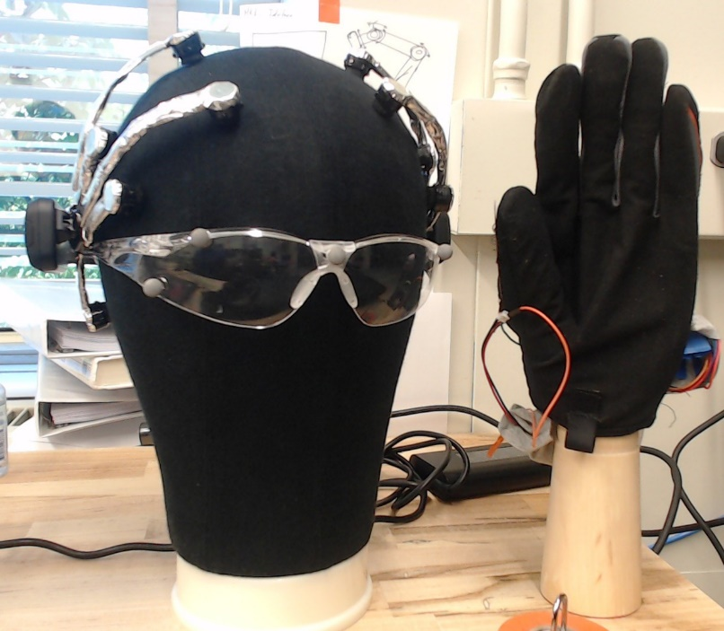
Conclusion and Future Work
This study is part of a greater study at NIST for quantifying HRI and HMI systems as being conducted by the Intelligent Systems Division.
These studies will be looking at the use of state-of-the art technologies being utilized such as virtual reality, augmented reality, brain computer interface, or wearable technologies.
Future work will incorporate more different types of technology in the future that can also potentially allow users to control a robot in an effective manner.
NIST will be conducting live trials to experiment on currently developed technology such as this and other tools
NIST Engineering Laboratory

Slide 14
Questions?
Special thanks to:
Jeremy Marvel
Shelly Bagchi
Megan Zimmerman
Project Files are available on GitHub
Thank you for NIST SURF 2019!

Slide 15
NIST Disclaimer
Certain commercial equipment, instruments, or materials are identified in this paper to foster understanding. Such identification does not imply recommendation or endorsement by the National Institute of Standards and Technology, nor does it imply that the materials or equipment identified are necessarily the best available for the purpose.
NIST Engineering Laboratory

Slide 16
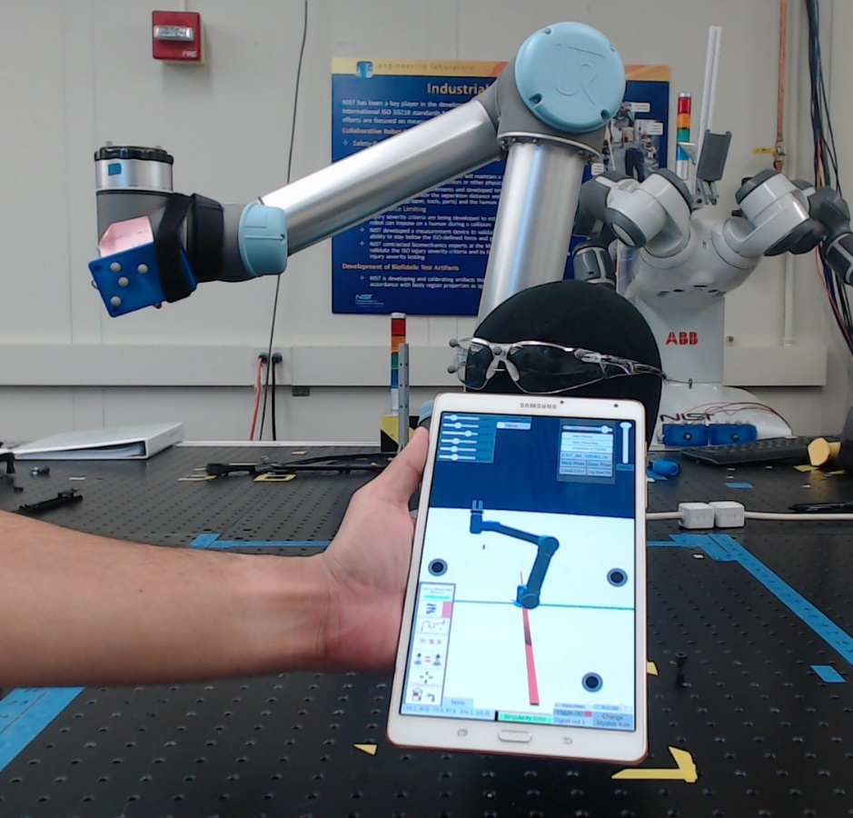
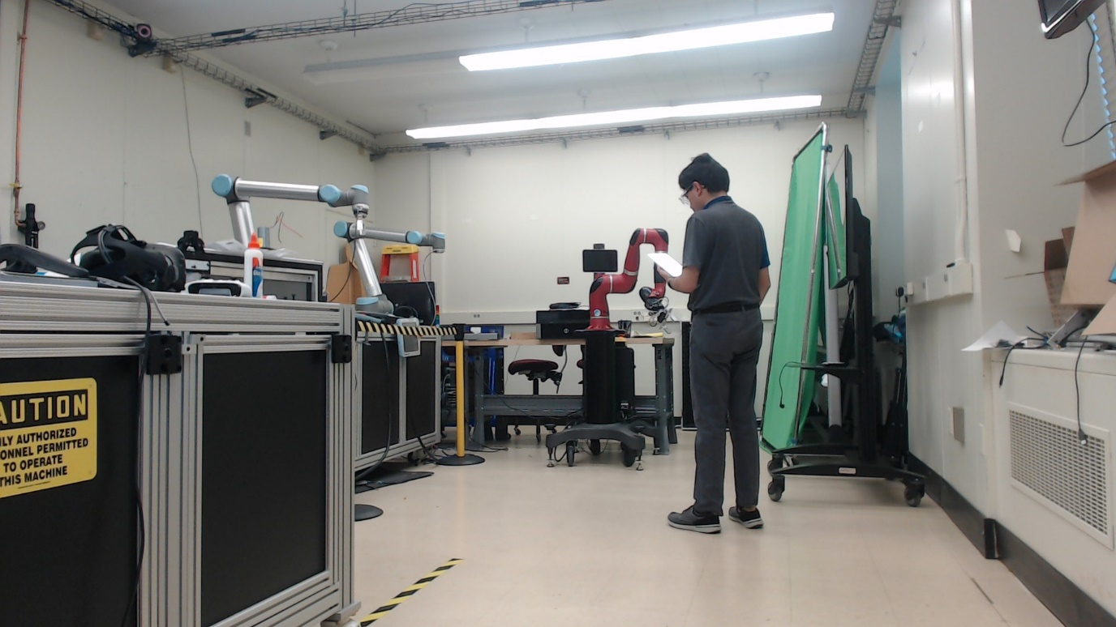
Examples of Live Use of System
NIST Engineering Laboratory

Slide 17
Methodology - Continued
There are various contingencies to a good user interface for HRI or HMI; these include but are not limited to the following:
Performance
Utility of mixed initiative
Situational Awareness
Awareness of operator
Safety
These are not all possible categories to quantify HRI or HMI performance but some of the important aspects
NIST Engineering Laboratory

